Slide 1
Image Analyzer and Converter
Team: Bangău Alexandru, Boţa Alina, Buleandră Cristian, Constantinescu Adrian,
Dan Veronica,Georgescu Andrei
Coordinating Teacher: Prof. dr. ing Brezovan Marius
Specialization: Computers in English, 3rd year

Slide 2
Project Requirements
User and System Requirements

Slide 3
User Requirements
The user shall be able to:
Open and save any image in various format files including JPG, BMP, PNG, TIFF and more;
Preview and adjust the image’s brightness and contrast;
Apply greyscale and sepia filters;
View the image’s RGB histogram;
View the original image next to the edited one;
Rotate the image clockwise and counter clockwise;
Flip the image vertically and horizontally.
The application’s main objective is to correctly display an image saved in multiple file formats and offer the user the possibility to edit, adjust and save it.

Slide 4
System Requirements
Data constraints:
The file types that the application will work with are: JPG, BMP, PNG, TIFF, YUV.
Functions and processes constraints:
The implementation will be done in an object oriented language (Java) and the development technique is based on protyping.
Functional Requirements

Slide 5
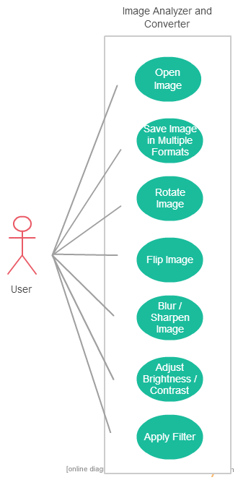
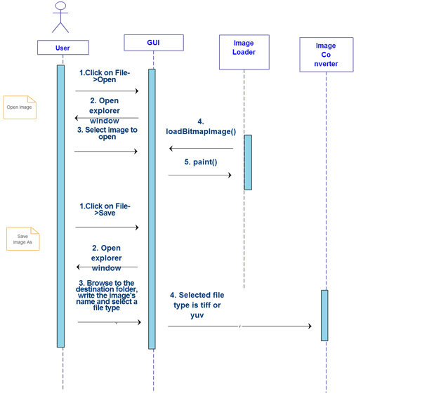
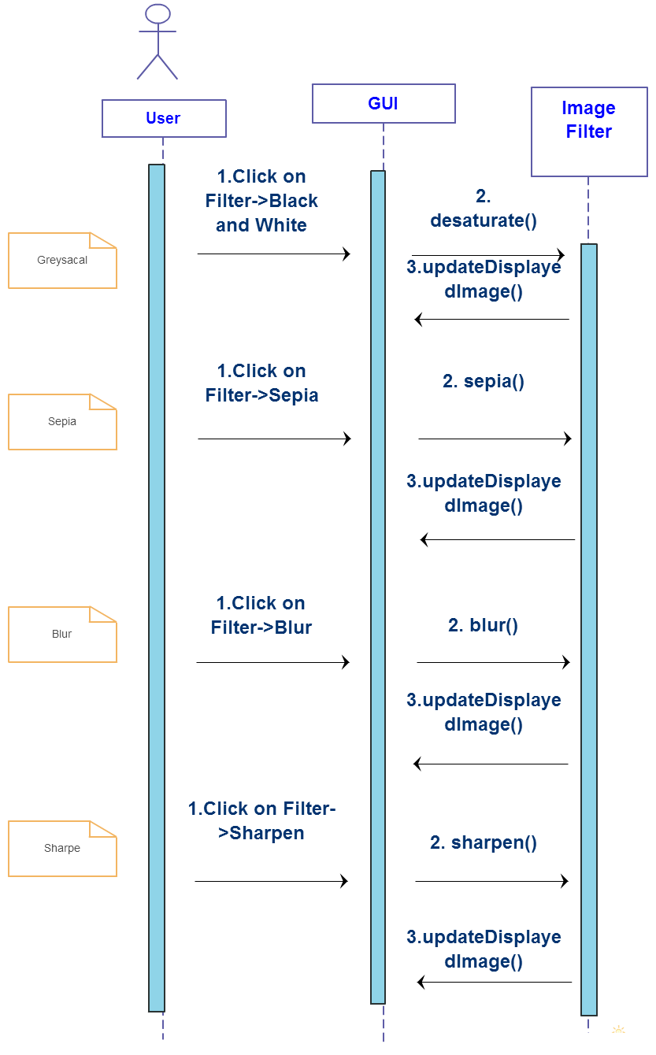
Functional Requirements UML Diagrams

Slide 6
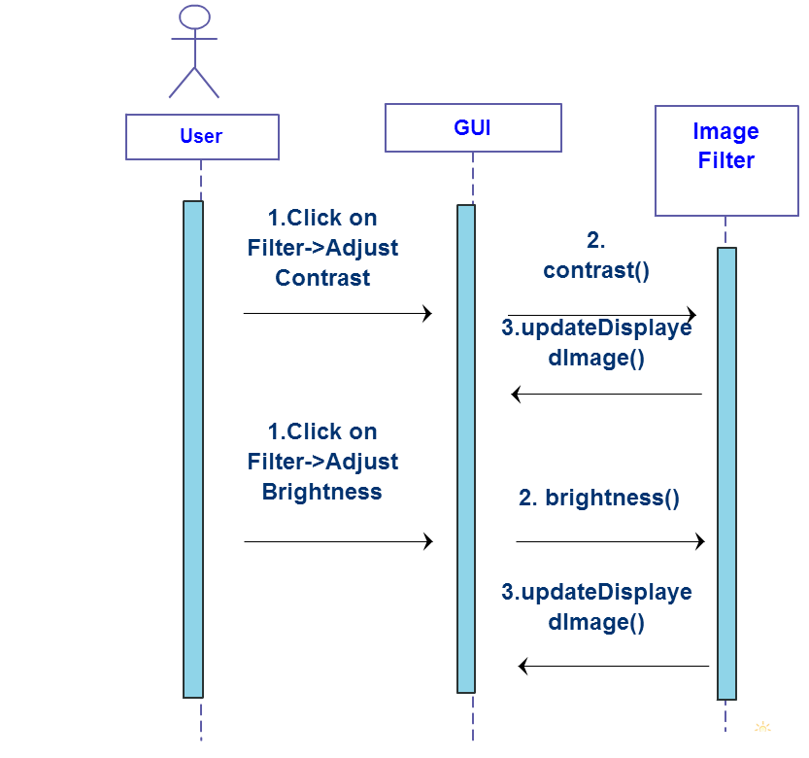
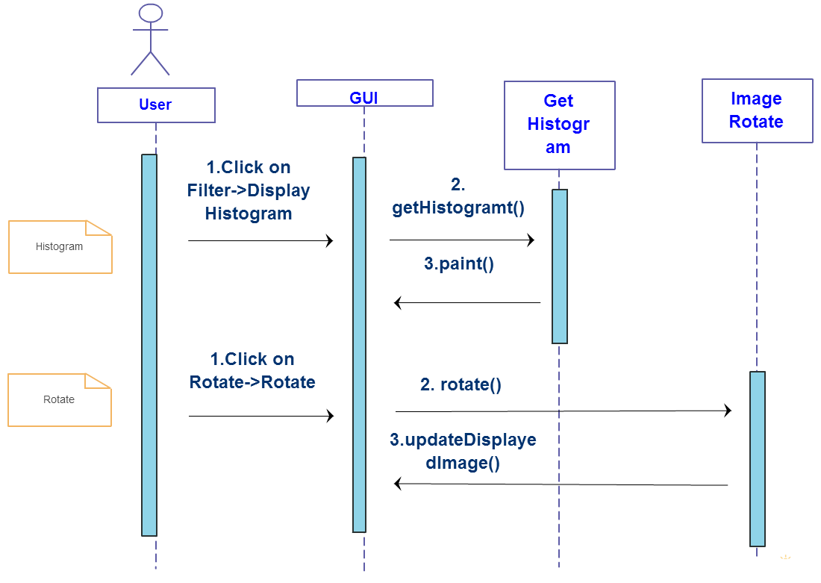
Functional Requirements UML Diagrams

Slide 7
System Requirements
1. Product Requirements
The graphical user interface should be intuitive and implemented with Java Swing.
2. Organization Requirements: the project’s development is composed of 4 phases:
Inception
Deadline: 10.04.2015
Contents: initial requirements, initial architecture, initial work items
First Prototype
Deadline: 8.05.2015
Contents: release plan, prototype
Second Prototype
Deadline: 19.05.2015
Contents: release plan, prototype
Final Delivery
Deadline: 8.06.2015
Contents: user documentation, final binary
3. External Requirements
The images uploaded by users should not be saved anywhere else except where the user wants them to and should not be distributed or used by anyone except the user.
Non- Functional Requirements

Slide 8
Project Architecture
The system’s model

Slide 9
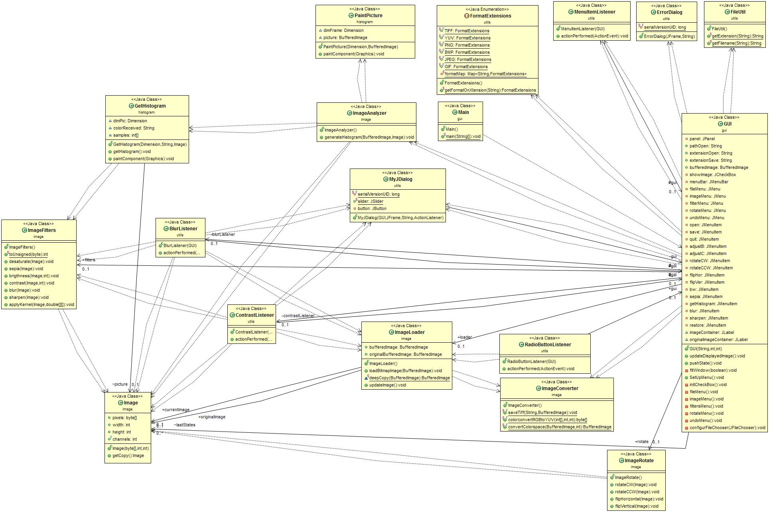
Class Diagram

Slide 10
Project Implementation
Implementation’s Description

Slide 11
Project Implementation
The GUI is created in Java Swing and is composed of: a JFrame that contains a JMenu and each menu element has an associated listener and icon. The most complex listeners are the open and save ones that involve a FileChooser. For the most important commands, key strokes were assigned.
GUI

Slide 12
Project Implementation
Byte specific filters only change the value of one byte (one channel) at each iteration step:
Brightness
This filter increases the value of each byte in the pixels array with a given intensity. The brightness intensity can be between -255 and 255, but the user interface includes -100% > 100% slider range that gets mapped to this interval.
Contrast
This filter makes light pixels lighter and dark pixels darker. This is done by iterating through each byte in the pixels array and if the value is larger than 127 it gets increased by the contrast intensity, otherwise it gets decreased. The contrast intensity can be between -100 and 100.
Byte specific filters

Slide 13
Project Implementation
Pixel specific filters only change, at each iteration step, the value of one pixel considering only the value of that pixel (three channels: R,G,B) :
Black & White (desaturate)
Each pixel gets its RGB channels changed to the same value, which is the average of those three channels: R = G = B = avg(R,G,B). An improvement is that instead of directly using the avg we use an weighted average to compensate for the different intensities that the human eye sees the colors at. (eg: Blue channel is less visible to the human eye, so we use a smaller weight for it).
Sepia
Each pixel gets its RGB channels changed to distinct values, based on some weights for each channels, weights that mostly increase the Green and Red channels.
Pixel specific filters

Slide 14
Project Implementation
Kernel specific filters change the value of each pixel based on the pixel values around it and the kernel (convolution matrix) given. The convolution matrix contains the width and height of the neighbouring area to consider and also the weights for each neighbour. Any filter that uses a kernel can be implemented by simply calling the applyKernel function with a different kernel. The ones implemented in this project are:
Blur
The kernel of size 3x3 contains weights so that, when applied, it averages the pixel values around the center pixel, but keeping the center pixel the dominant one (largest weight).
Sharpen
The kernel of size 3x3 contains weights so that the value of the center pixel is increased more if the pixels’ values around it are higher. So, by using this weights, it makes sure that each pixel intensity is increased in order to make it stand out more.
Kernel specific filters

Slide 15
Project Implementation
The rotations are done using the original image’s pixel array and rotating or flipping it accordingly. There are implemented only the CW rotations and horizontal flip, since the CCW rotation is done by rotating the image CW three times and vertical flip is done by two CW rotations and a horizontal flip.
Rotations

Slide 16
Project Implementation
The histogram is generated using ImageFilters and sampling into a graph every color (red, green and blue) from the image.
Histogram

Slide 17
Project Implementation
The conversions are done for TIFF and YUV file formats:
TIFF – there is used TIFFImageWriteParam ;
YUV – the file is converted using the following formulas for obtaining the necessary channels:
R = (aRGB[index] & 0xff0000) >> 16;
G = (aRGB[index] & 0xff00) >> 8;
B = (aRGB[index] & 0xff) >> 0;
Y = ((66 * R + 129 * G + 25 * B + 128) >> 8) + 16;
U = (( -38 * R - 74 * G + 112 * B + 128) >> 8) + 128;
V = (( 112 * R - 94 * G - 18 * B + 128) >> 8) + 128;
Conversion

Slide 18
Detailed Running
A running example

Slide 19
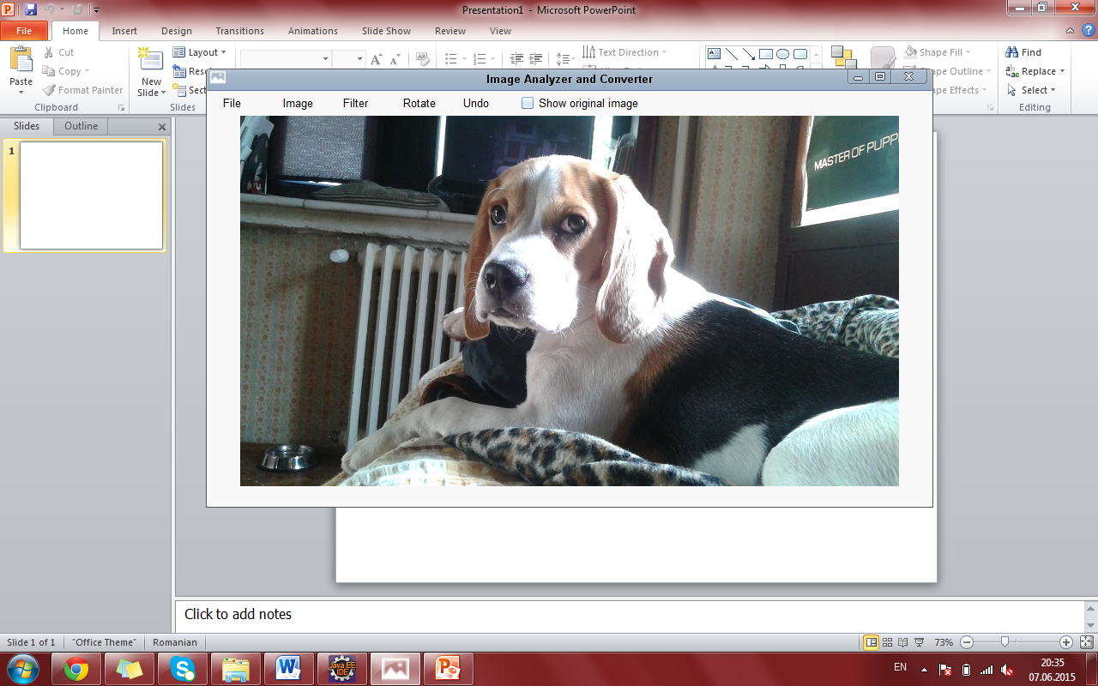
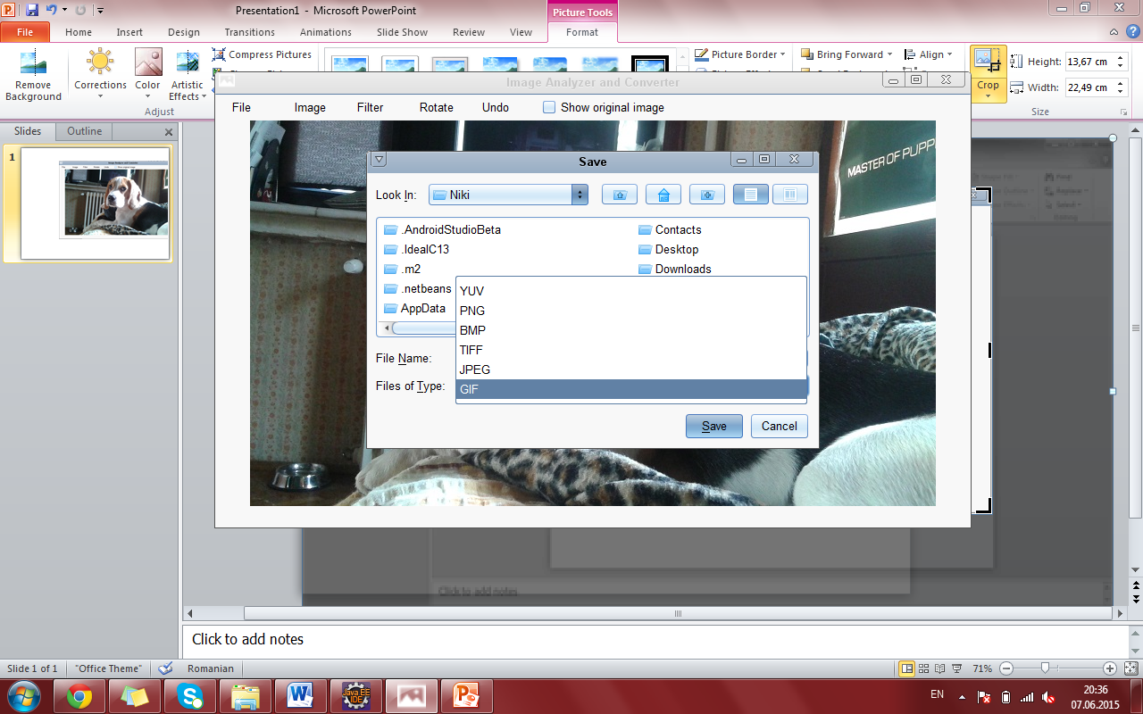
Open Image Save Image

Slide 20
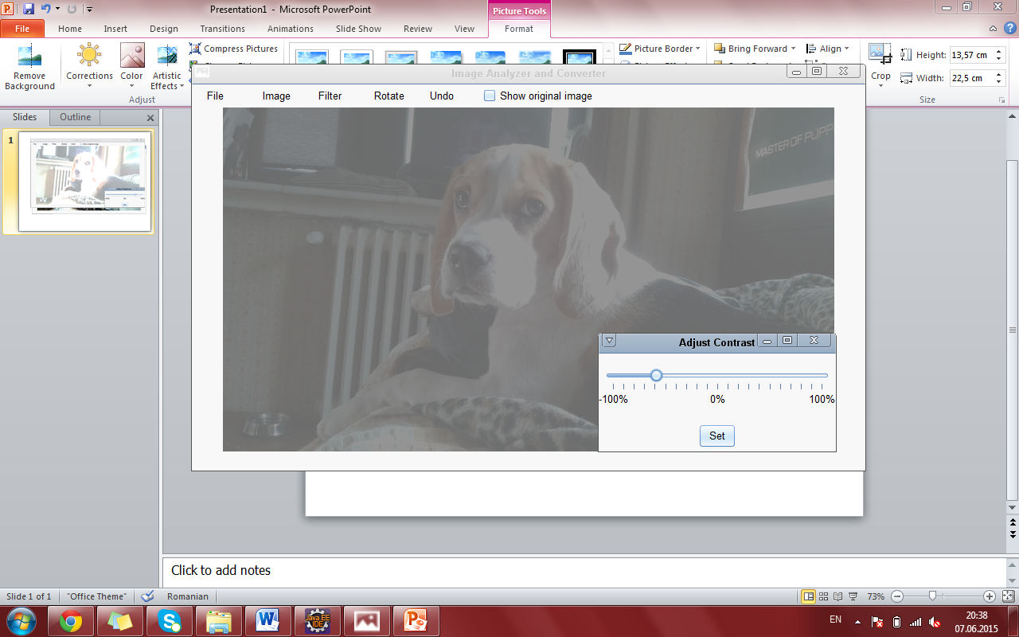
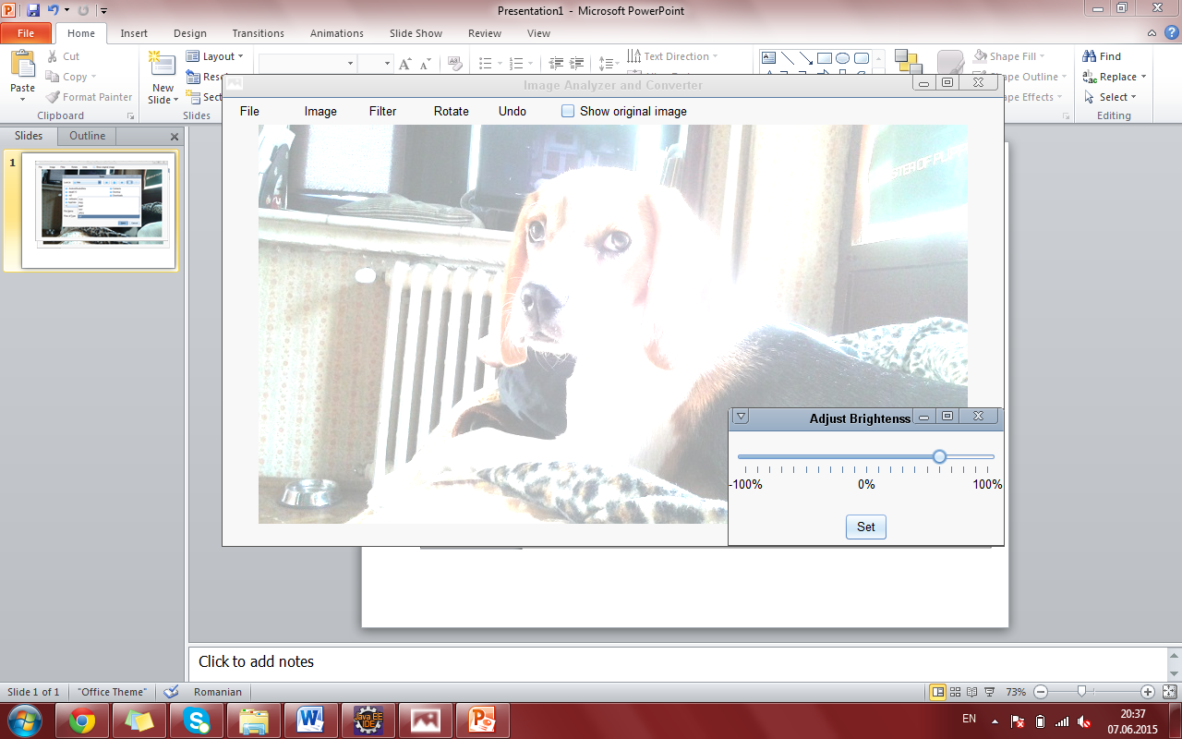
Adjust Contrast Adjust Brightness

Slide 21
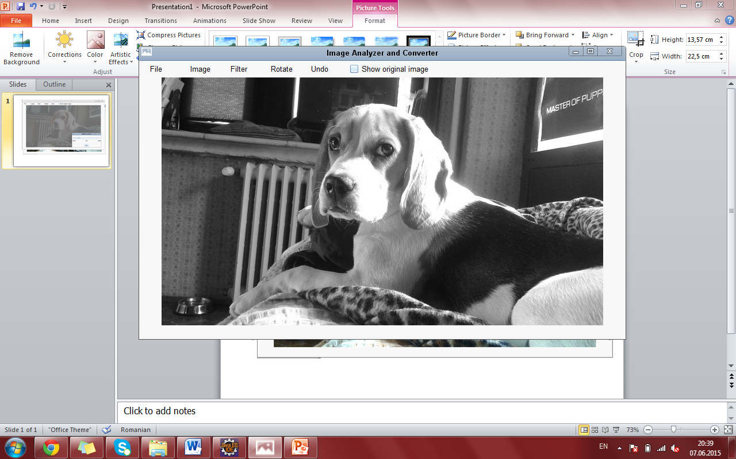
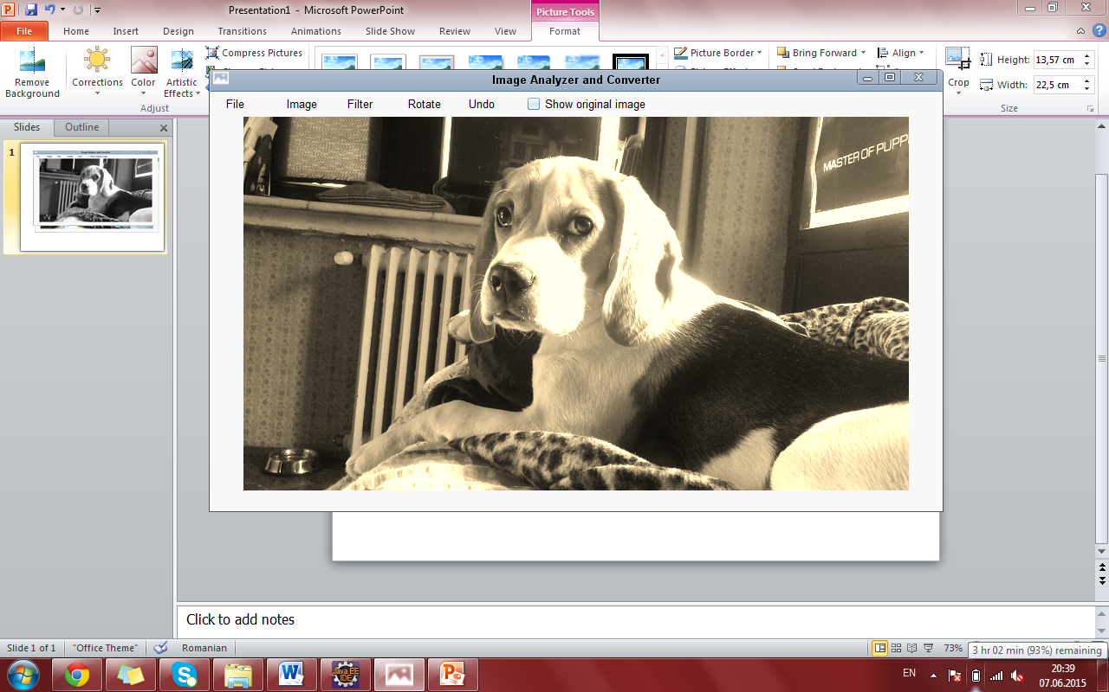
Greyscale Sepia

Slide 22
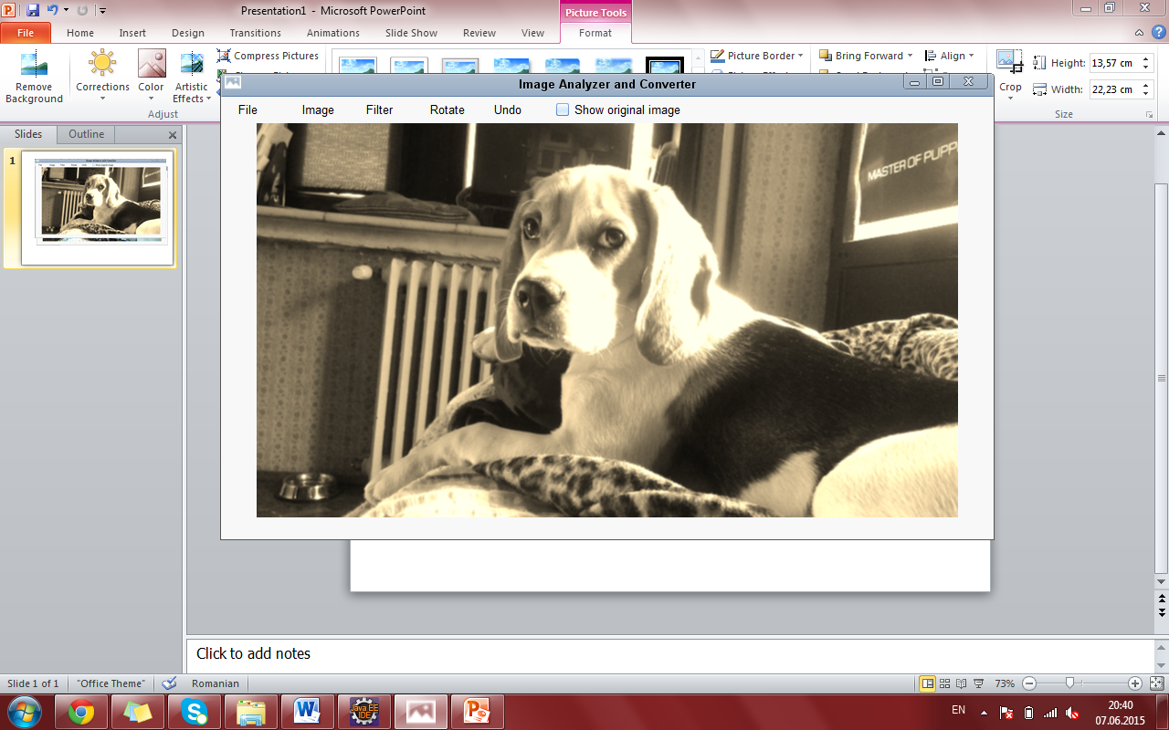
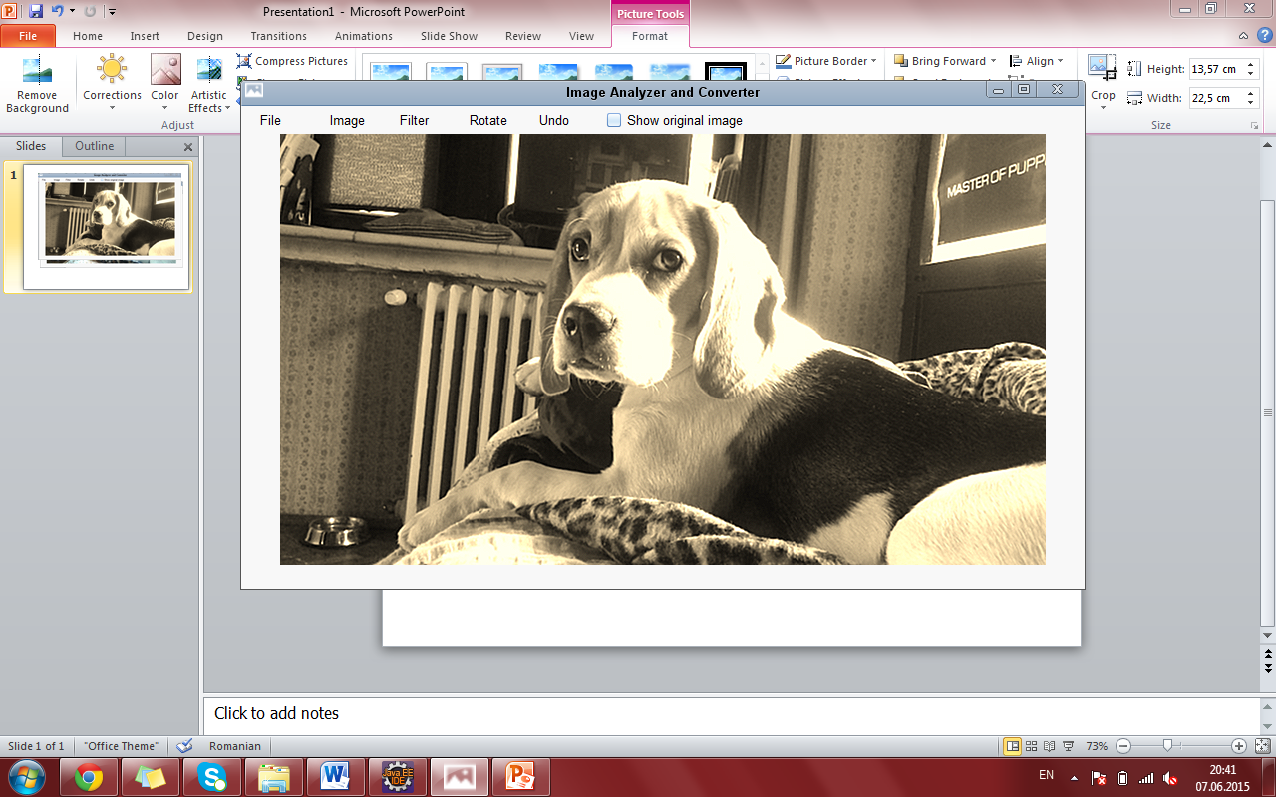
Blur Sharpen

Slide 23
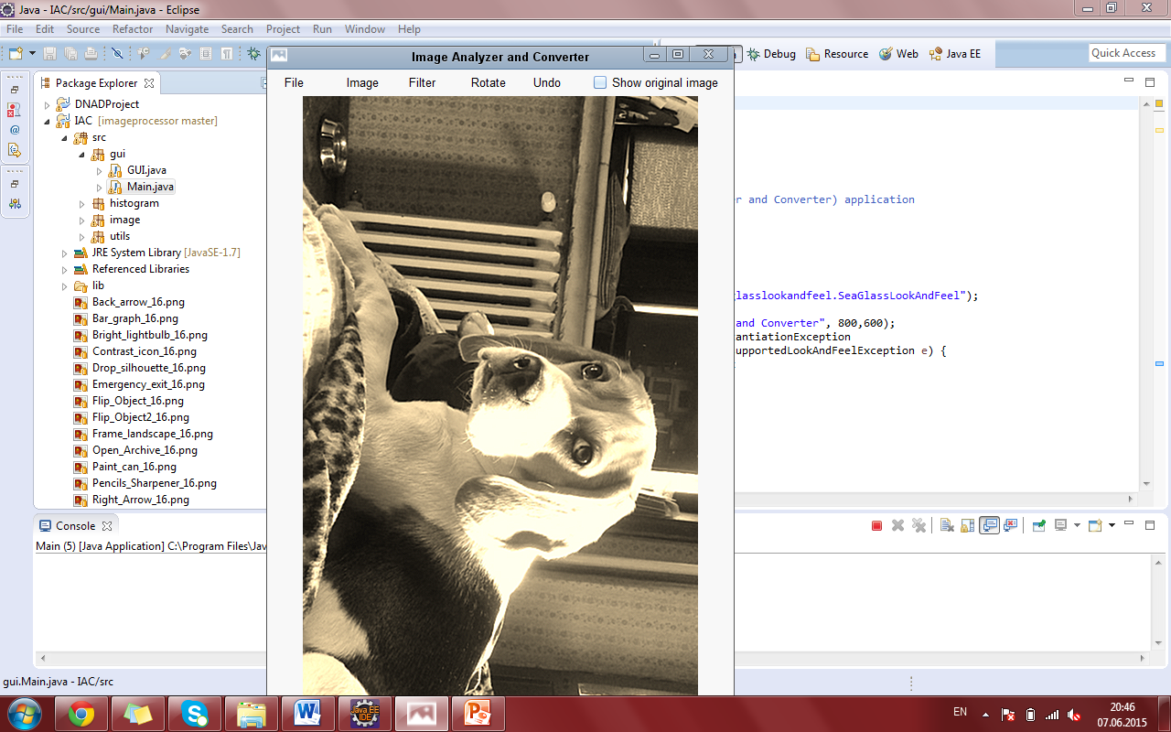
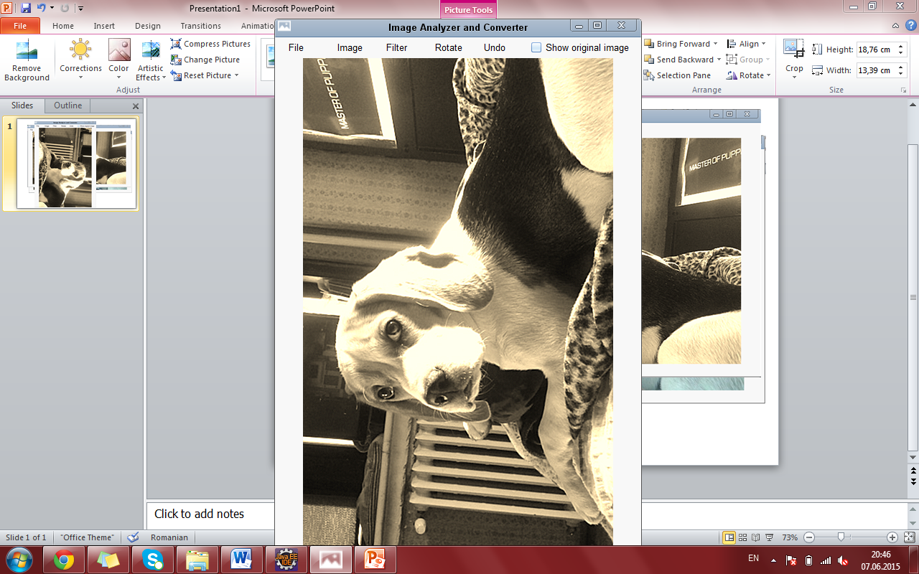
Rotate Clockwise Rotate Counter Clockwise

Slide 24
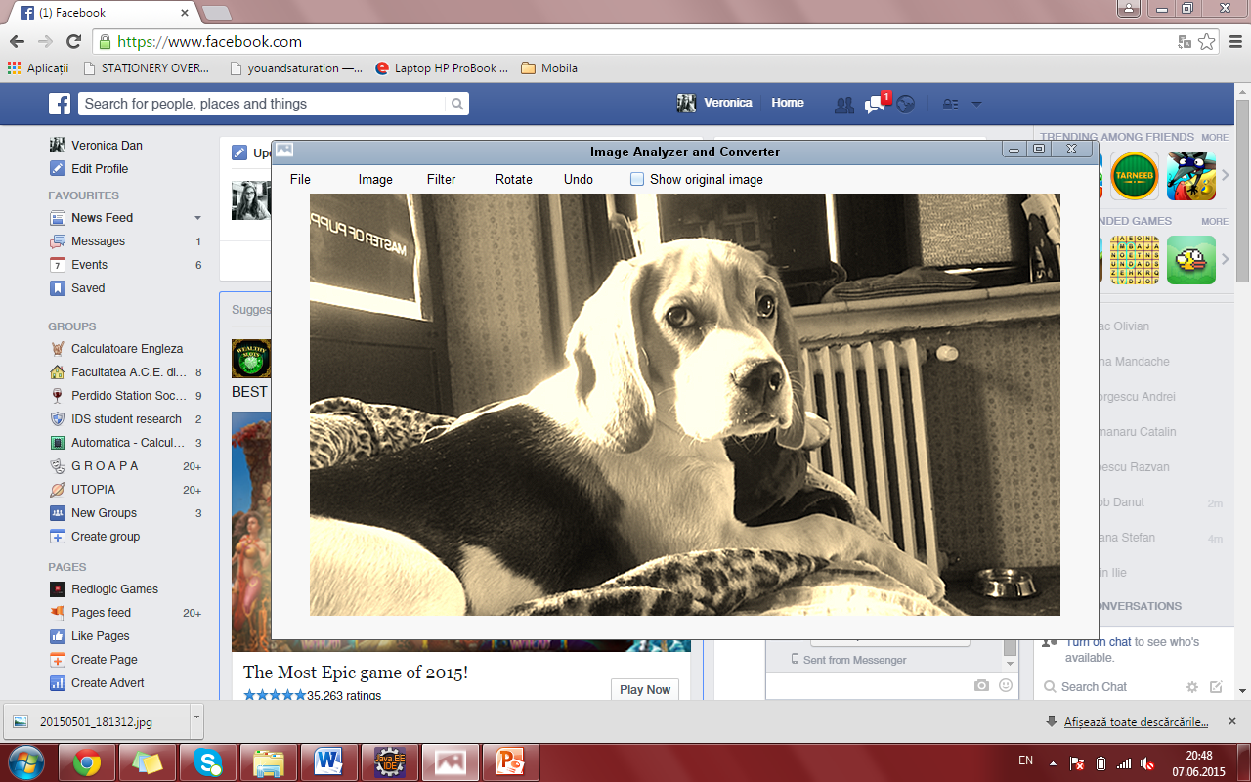
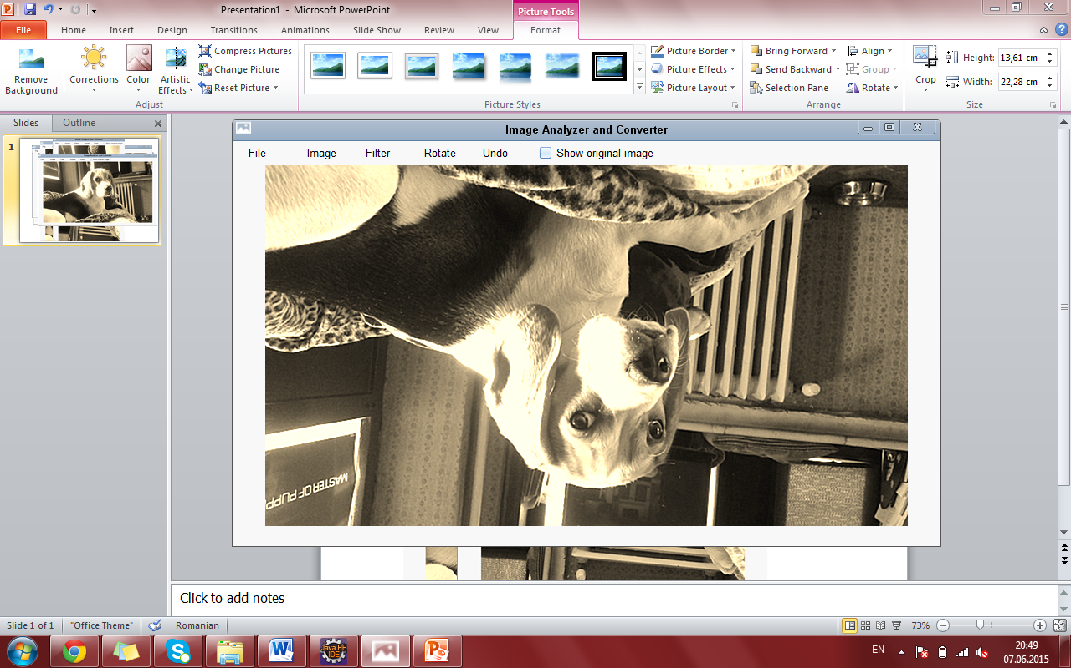
Flip Horizontally Flip Vertically

Slide 25
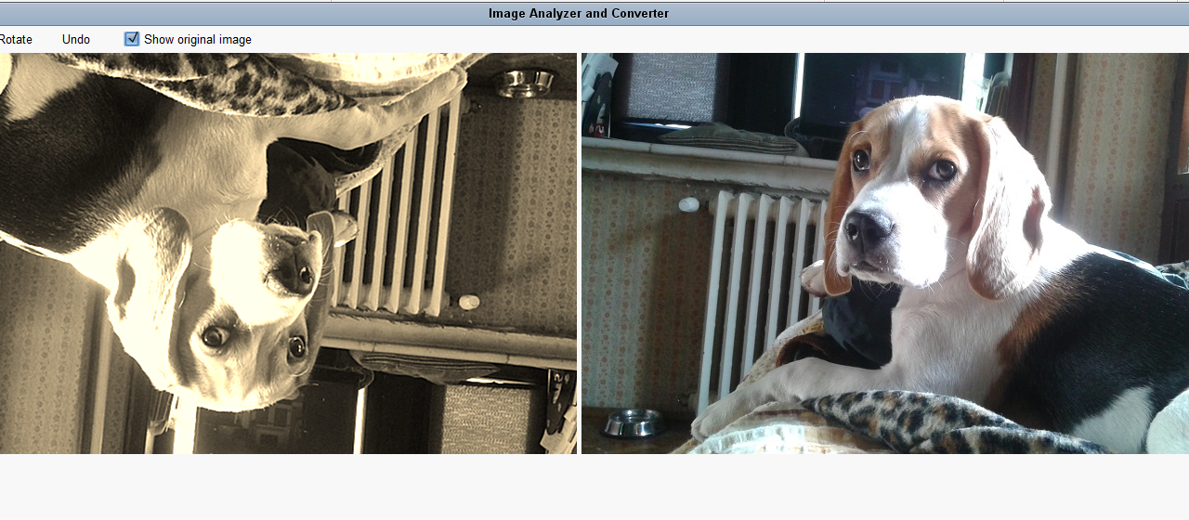
Display Original Image

Slide 26
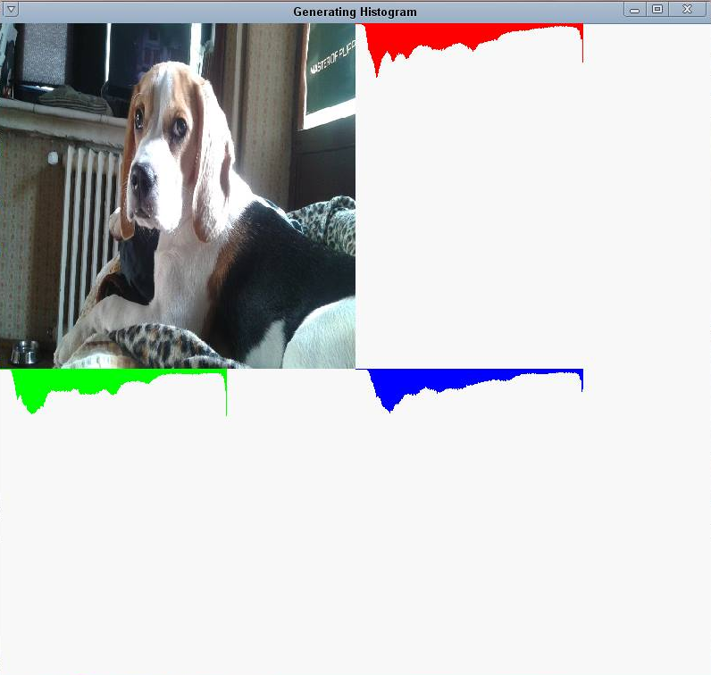
Display RGB Histogram

